Slide 1
Measuring the Fraction of CO2 in Air with Fourier Transform Infrared Spectroscopy
Esther Lin | ENPH 352 | 11726156

Slide 2
Objectives
To measure the fraction of CO2 in air
To measure and understand the absorption spectra of several gases

Slide 3
Theory
In the mid-infrared region of the electromagnetic spectrum, molecules absorb light through the interaction between the photons and the vibrating electric dipoles of the molecule.
In FTIR, a beam carrying many frequencies irradiates a sample. We measure how much of that beam is absorbed and transmitted by the sample.
With the transmission and absorbance spectra, we can identify the molecules in the sample.
Vibrational modes of molecules
http://brussels-scientific.com/?p=5975

Slide 4
General Setup
The FTIR is based on the Michelson interferometer. A multimode laser transmits light on the beamsplitter, which splits the light into two branches. The first branch hits the stationary mirror and gets transmitted to the detector through the gas cell. The second beam travels to the scanning mirror. By translating the scanning mirror, different wavelengths are selected to pass through the gas cell. The detector records the interaction of the beams with the molecules (interferogram) in the gas cell and sends the information to a computer for Fourier Transform analysis.
Notes:
Big paragraph. List components bullet points.

Slide 5
Method: Data Collection
Interferogram captured with no gas cell, and the FTIR flushed with N2. We proceed to capture interferograms where the gas cell is in place, flushed with N2, CO2, and air, all with FTIR flushed with N2.
Notes:
Caption interferogram. Take out fluff. Do caption style.

Slide 6
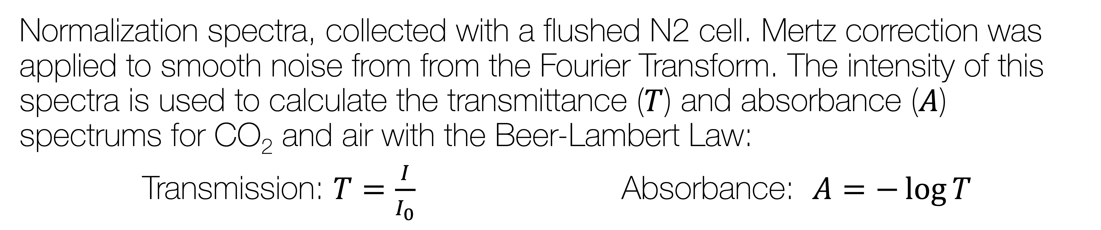
Method: Data Analysis
Normalization spectra, collected with a flushed N2 cell. Mertz correction was applied to smooth noise from from the Fourier Transform. The intensity of this spectra is used to calculate the transmittance ($T$) and absorbance ($A$) spectrums for CO₂ and air with the Beer-Lambert Law:
Transmission: $T=\frac{I}{I_{0}}$Absorbance: $A=−\log{T}$
Notes:
Less procedural, more general.

Slide 7
Results: Spectrums of CO₂
Say something

Slide 8
Results: Mertz Correction
Comparison of spectra with and without Mertz correction. The Mertz correction method modulates the spectra with a triangular signal, to smooth out ringing with taking the Fourier transform of the interferogram. The spectrum with the Mertz correction is smoother and less noisy.

Slide 9
Results: Spectrums of Air
Say something

Slide 10
Results: Summary
Bond | Measured Wavenumber [cm-1]
CH | 4000
OH | 1500
smth
smth
Measured Fraction of CO2 in Air: Some value

Slide 11
Conclusions
Promising method?
Can see different motions of molecules: doppler, pressure, temperatures, etc.

Slide 12
References

